Slide 1
Ocean Animals

Slide 2
Types of Animals
There are two main types of animals: Vertebrates and Invertebrates
Vertebrates (have a backbone):
  Mammals
  Reptiles
  Amphibians
  Birds
  Fish
Invertebrates (do not have a backbone):
  Arthropods

Slide 3
Vertebrates
All vertebrates have a backbone
All vertebrates have a skeleton on the inside of their body to protect their organs
All vertebrates are covered in skin
  Soft
  Slimy
  Scaly

Slide 4
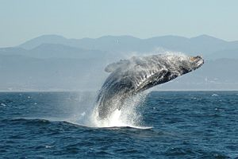
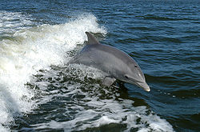
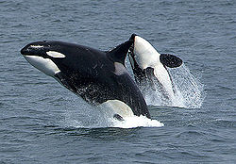
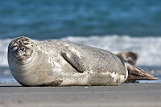
Mammals
Every mammal:
  Has a backbone
  Has hair or fur
  Is warm-blooded
  Breathes oxygen
  Has live babies
  Drinks milk while they are babies

Slide 5




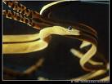
Reptiles
Every reptile:
  Has a backbone
  Rough scaly skill
  Lay soft eggs

Slide 6
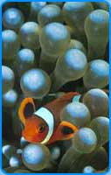
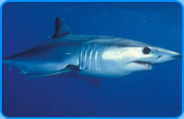
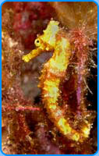
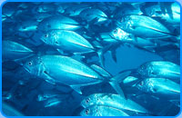
Fish
Every fish:
  Has a backbone
  Lives underwater
  Has gills for breathing
  Has fins
  Has scales
  Lays eggs

Slide 7
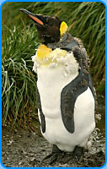
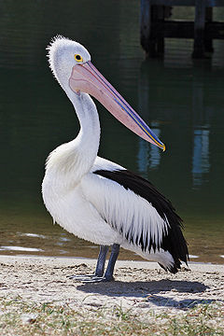
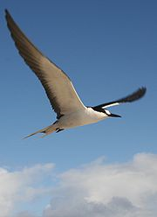
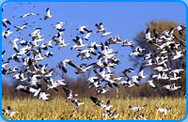
Birds
Every reptiles
  Has a backbone
  Has feathers
  Is warm-blooded
  Lays eggs
  Has a beak

Slide 8
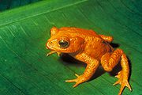
Amphibians
Every amphibian:
  Has a backbone
  Lives in and out of water
  Breathes oxygen
  Born in the water
  Lays eggs
The only type of animal that does not live in the ocean

Slide 9
Invertebrates
Do not have a backbone
Organs are protected from the outside with a shell or exoskeleton
Arthropods make up 90 percent of the Earth’s animals

Slide 10
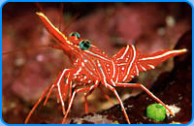
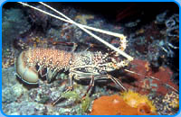
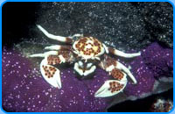
Arthropods
Every arthropod:
  Does not have a backbone
  Has six or more legs
  Jointed legs
  Segmented bodies

Slide 11
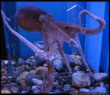


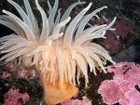
Aquatic Invertebrates
Some invertebrates do not have a shell. Instead, they have flexible skin.
Examples of aquatic invertebrates:
  Octopus
  Squid
  Jellyfish
  Sea anemones

